Slide 1
Final Year Project: Week 4 of 20
Marij Qureshi 16th Jan 2020
Robust Optimisation of Composite Panels

Slide 2
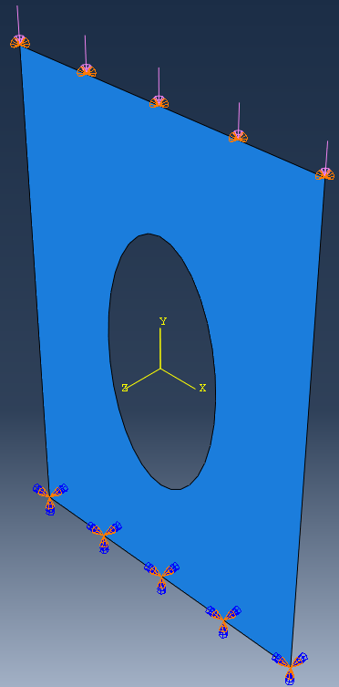
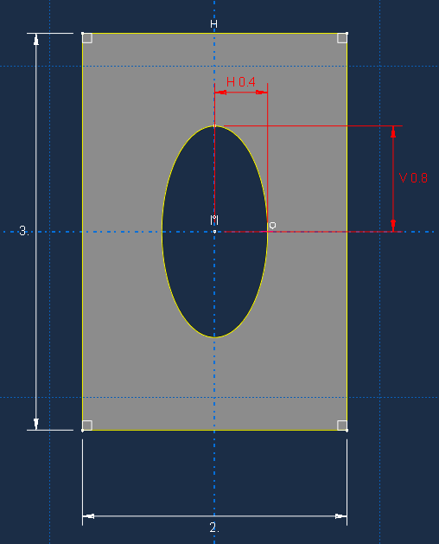
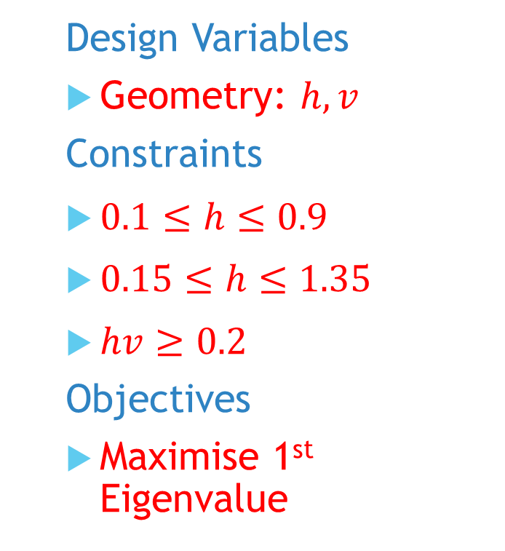
Model
Design Variables
Geometry: $h,v$
Constraints
$0.1≤h≤0.9$
$0.15≤h≤1.35$
$hv≥0.2$
Objectives
Maximise 1st Eigenvalue
Notes:
Post-buckling reliability design (vary lay-up)
Chapter 7: Robust Multilevel Design Optimization of Composite Panels
Robust and Reliability-Based Design Optimization of a Composite Floor Beam

Slide 3
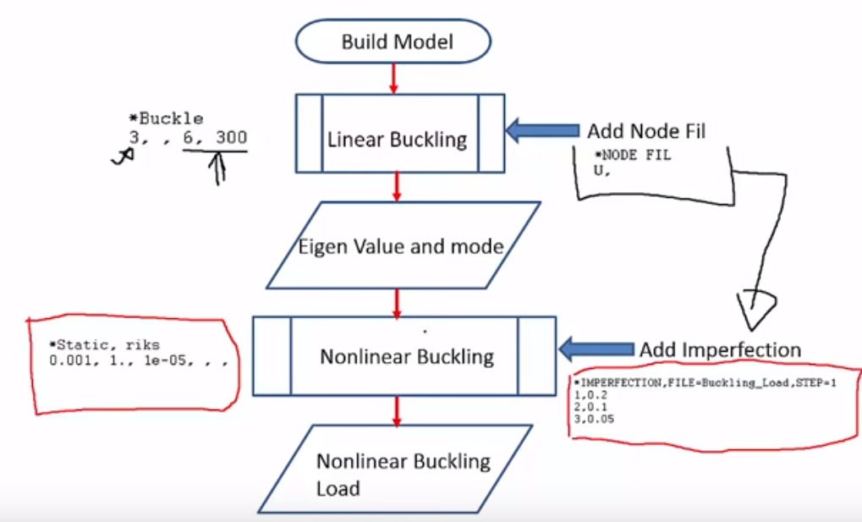
Buckling Analysis

Slide 4
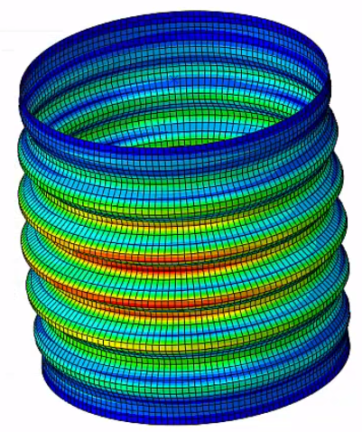
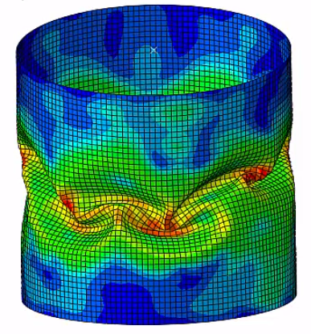
Buckling Analysis

Slide 5
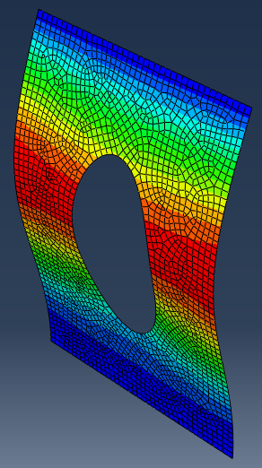
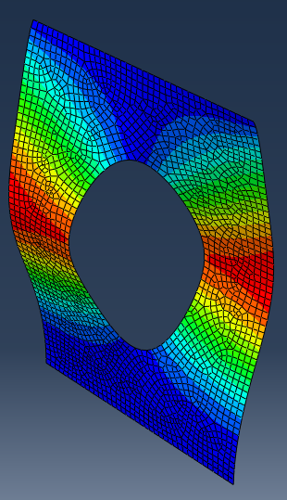
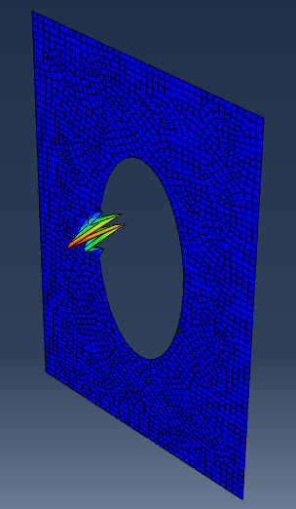
Buckling Analysis

Slide 6
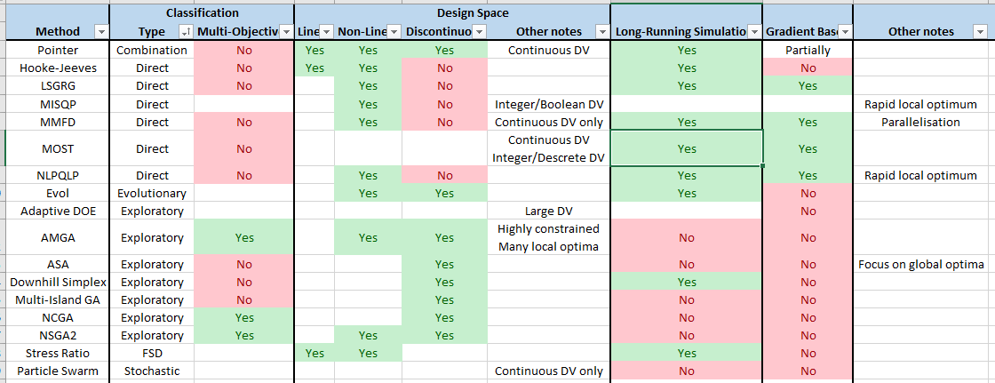
Optimisation Algorithms

Slide 7
Optimisation Algorithms
 | Gradient | Direct | Exploratory | Combined
Single-Objective | NLPQLP MMFD LSGRG MISQP | Hooke-Jeeves Downhill Simplex | ASA MIGA | MOST POINTER
Multi-Objective |  | Stress-Ratio | NSGA2 NCGA AMGA Particle Swarm Evol Adaptive DOE

Slide 8
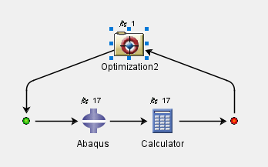
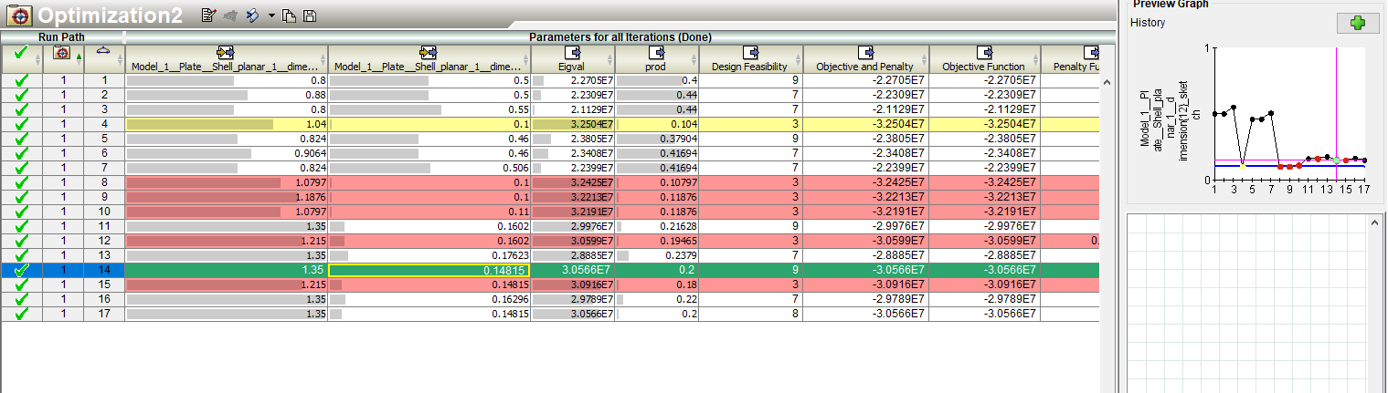
Optimisation Algorithms
Speed issues
Convergence to local optima (tuning)
Unexplained simulation errors

Slide 9
Next Steps
Further reading on optimisation methods – 10 papers
Complete deterministic study for plate with hole
Set up mono-string model

Slide 10
Project plan
Workflow Test Case
Main Test Case
Design Studies
Computation
Final Report Work
Design Study Flow / Test Problem
Optimisation Methods
Results Analysis
Analytical Work + Research
Wks 17-19
Wks 1-3
Wks 4-7
Wks 9-16
Week | 1 | 2 | 3 | 4 | 5 | 6 | 7 | 8 | 9 | 10 | 11 | 12 | 13 | 14 | 15 | 16 | 17 | 18 | 19
Month | Jan |  | Feb |  |  |  | Mar |  |  |  |  | Apr |  |  |  | May

Slide 11
Questions
Methods focusing on local minima (e.g. MISQP)
Does the algorithm incorporate repeat start-points over the design space?
Or would I need to incorporate DOE (latin hypercube) to set this up manually
Python scripting with Abaqus/Isight
When does Abaqus choose to run a python script when simulating? Any way to control execution before/after simulation?

